Slide 1


Hexatronic
Design Guidelines
Hexatronic US Inc.
4040 Finn Way STE 240,
Lexington, KY
Prepared by: Roxanne Adino

Slide 2
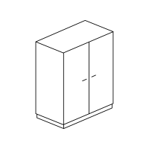


FTTH High Level Overview The diagram below shows the High level design for FTTH network
Up to 96 homes per FDH for Pure SDU
With 3x1:32 Splitter
FDH
Fiber cable for FDH + P2P cables
1F cable/Homes connect
Micro ducts
5/3.5 Micro ducts
FTB 1 SDU
1F cable/unit (4F)
OLT
5/3.5 Micro ducts
FTB 4 QUAD
1F cable/unit (12F)
5/3.5 Micro ducts
FAT 12
5/3.5 Micro ducts
P2P: 1F cable/32 unit + spare
FDH 64
Distribution Network
Drop Network
Customer premise

Slide 3
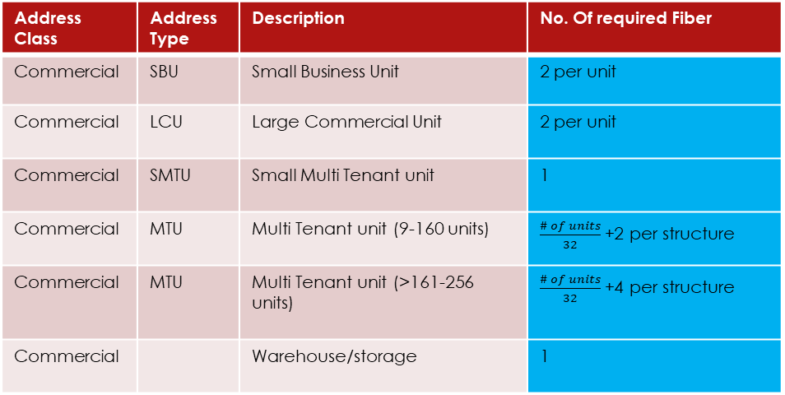
Fiber Allocation
Address Class | Address Type | Description | No. Of required Fiber
Residential | SFU | Single Family Unit | 1 (P2M)
Residential | QPX | Fourplex | 4 (P2M)
Residential | SMDU | Small MDU, 12 residences in one structure | 12 (P2M)
Residential | LMDU | 30 above or more residences in one structure | Unit/32 +1F spare (P2P)
Other |  | Club House | 1 (P2P)
Other | VAC | Vacant lot | 0
Other | CHC | Church/Place of worship | 1
Other | GOVT | Government (Post office/fire stations/courthouses) | 2
Other | GOVT | Police stations | 2
Other | GOVT | Hospital | 1
Other | GOVT | School | 2
Other | PRIVATE | Large private complex (universities/colleges/business campuses | 2
Address Class | Address Type | Description | No. Of required Fiber
Commercial | SBU | Small Business Unit | 2 per unit
Commercial | LCU | Large Commercial Unit | 2 per unit
Commercial | SMTU | Small Multi Tenant unit | 1
Commercial | MTU | Multi Tenant unit (9-160 units) | $\frac{\# of units}{32}$+2 per structure
Commercial | MTU | Multi Tenant unit (>161-256 units) | $\frac{\# of units}{32}$+4 per structure
Commercial |  | Warehouse/storage | 1
Still for approval from hexatronic

Slide 4
Cabinet Capacity Rules
FDH #
2 Fiber (1)
Multiple OLT Area Ring Topology
3x1:32 SPLITTER
96 Homes
2 Fiber (1)
OTHER OLT
OTHER OLT
2 Fiber (1)
2 Fiber (1)
12 Fiber (6)
OTHER OLT
FDH #
2 Fiber (1)
OLT
12 Fiber (9)
3x1:32 SPLITTER
96 Homes
2 Fiber (1)
2 Fiber (1)
2 Fiber (1)
12 Fiber (3)
2 Fiber (1)
FDH #
2 Fiber (1)
3x1:32 SPLITTER
96 Homes
Feeder
Distribution Network
2 Fiber (1)
2 Fiber (1)

Slide 5
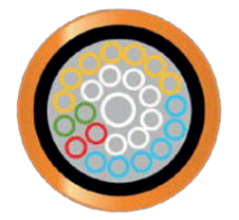
Duct Layout sample design 1
Duct Joint closure underground branching with capacity of 1-24way 5/3.5 ducts, and up to 4x1 way branch off or 8x1 way branch
FDH
FDH
OLT
24 way 5/3.5 (1x10/8)
24 way 5/3.5 (1x10/8)
DJC
1 way 5/3.5
1 way 5/3.5
1 way 5/3.5
1 way 5/3.5
Flower Pot
Sharing 2 houses per pot

Slide 6
Duct Layout sample design 2
Duct Joint closure underground branching with capacity of 1-24way 5/3.5 ducts, and up to 4x1 way branch off or 8x1 way branch
FDH
FDH
OLT
24 way 5/3.5 (1x10/8)
24 way 5/3.5 (1x10/8)
DJC
1 way 5/3.5
1 way 5/3.5
1 way 5/3.5
1 way 5/3.5
Fiber Termination Box

Slide 7
Underground installation Feeder and Distribution routes placement shall be considered as either of the following based on desktop study.
HDD
Open Trench
Micro Trench
Plough
Aerial Installation
Aerial cable Installation shall be double lashed to existing copper/strand when possible.
Existing aerial routes that passing other properties should not be followed as standard installation, rather find a better route that will not obstruct or pass other private property.
Note: Distribution placement shall vary as per site survey and permit limitations.

Slide 8
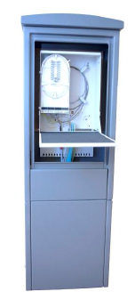
FDH (Fiber Distribution Hub) Fiber Access Terminal
Features
96 end user connections with microducts or drop cables
Up to 96/192* fiber splices
Extremely lightweight and robust design
Corrosion Resistant Aluminum
Handles all type of cables or microducts
Mid-span storage for distribution cable
Can be installed directly into ground or above concrete manhole

Slide 9
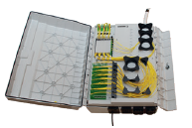
FDH (Fiber Distribution Hub) Fiber Access Terminal, Indoor
Features
Up to 64 end-users
The closure handles both 5 mm and 7 mm microducts. 3 mm microducts can be installed using the optional accessory
Type: Plastic, wall mount, IP54
Dimensions: 500x 76x182 mm
Capacity: up to 64 end users (SC)

Slide 10
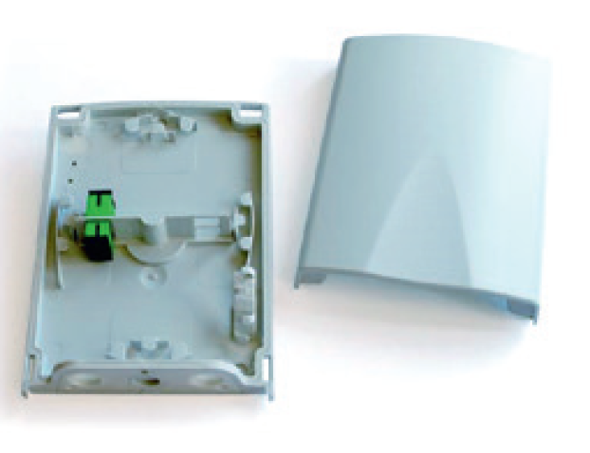
FTB (Fiber Termination Box) Indoor/outdoor
Features
Designed for termination of fibers outside premises in FTTx applications.
The box terminates and protects fiber or duct connections for the final drop cabling.
Type: Polycarbonate, wall mount, IP 54
Dimensions: 190x130x45 mm
Capacity: 4xSC

Slide 11

Fiber cable Design guidelines below relate to all air blown fiber cables.
OLT
48 Fiber
FDH
2 Fiber
Cable Type | Cable outer Diameter | Lengths
48 Fiber | 5.7 mm | 2000m, 4000m, 8000m | Microcable loose tube
12 Fiber | 1.4mm | 1000m, 2000m, 4000m | Air blown
2 Fiber | 1.1mm | 1000m, 2000m, 4000m, 6000m | Air blown

Slide 12


Duct Types and Sizes The micro ducts shown must be used for FTTH direct bury networks
Duct Usage description | Duct Size | Capacity | Type | Outer Coat Color | Lengths
2 Fiber- Residential Drop | 5/3.5mm | 2 way | Direct Buried installation | Orange | 500m 1000m 2000m 4000m
 |  | 4 way
12 Fiber- Distribution Network |  | 7 way
 |  | 12 way
 |  | 19 way
 |  | 24 way (1 way 10/8)
48 Fiber- Distribution Network | 10/8mm | 1 way | Direct Buried installation | Orange | 500m 1000m 2000m

Slide 13
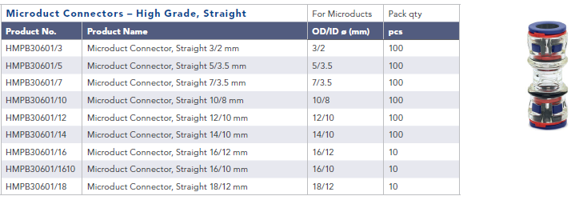
Microduct Accessories
Microduct Connectors – High Grade, Straight

Slide 14
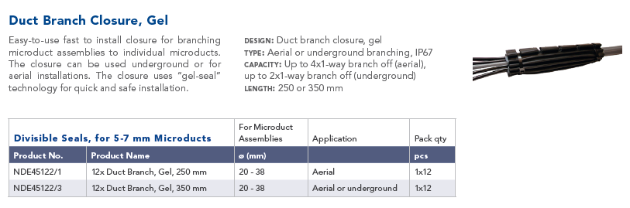
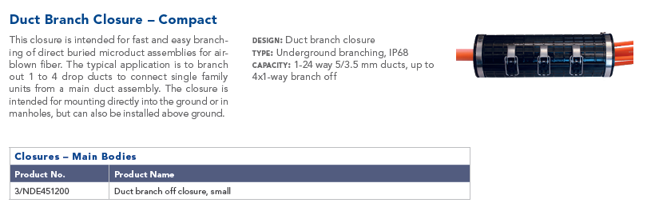
DUCT JOINTS AND DUCT BRANCHES
New duct closure:
8x1 way brach off

Slide 15
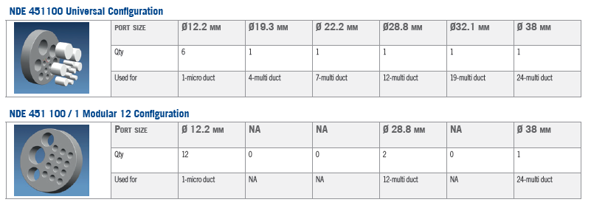
Duct Branch Closure, Medium Capacity – NDE 451 100

Slide 16
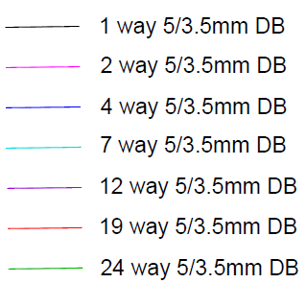




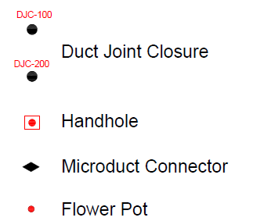
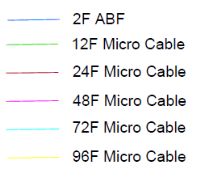
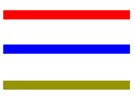



Design Symbols For Pre Sales Design/ High Level Design
Ducts
Equipment
Customer category
Others
Routelines
MTuD in carriage
Cables
MTuD in Foot Path
MTuD in Crossing
Open Trench in carriage
Open Trench in Foot Path
Open Trench in Grass
Open Trench in Customer

Slide 17
Summary keypoints:
Use HDD for road crossings
They need to have trench from property line to property for the HC
3F per cabinet with maximum of 96 Homes per cabinet
Buildings with 30 above units will have 1F per 32 units and a spare and are connected point to point from the OLT. Same with club house
They require BOQ for material and services
Limit drop distance to 1500’
Show trench surfaces in the BOQ
Place FDH cabinet in the middle of the serving area as possible
FDH port utilization can be at 100%
Air blown Fiber will be used for cable works installation method
Maximum point to point blowing distance is 1km or 3200 ft. For mid point blowing = 2km or 6500 ft (still for verification with hexatronic)
Pre Sales design request form will be provided by hexatronic to provide design requirements
Sample Document attachment:
Duct Layout
Drawing
Cable Layout
Drawing
Cable Schematic
Material BOQ
2F drop BOQ

